Slide 1

New NEM Service Design
Past, Present, Future
Ruud Schoonderwoerd
July 2016
IBM Confidential

Slide 2
Some terminology
<XML> A format for transporting data, and storing it as a document.</XML>
<XSD> XML schema definition. A schema defines the valid structure of an XML document (and is written in XML)</XSD>
<WSDL> Web Service Definition Language. An XML based definition of a web service, its operation, and schema (XSDs) </WSDL>
<SOAP> Protocol for interacting with web services. In NEM SOAP uses HTTP or MQ.</SOAP>
<A HREF="http://www.w3schools.com">Check this link to learn more.</A>

Slide 3
Designing the messages exchanged within NEM
EM
On Ramp
Each message requires the definition of Transfer Objects
LRPO
Business Rules
STPO
ESB

Slide 4

Evolution of NEM Service Design
IFW Generated
Fire Break
Trimming
Direct Design

Slide 5
IFW driven Service Design
IFW = Information Framework
Accessible through RSA
Set of data and capability models representing a financial institution
BOM = Logical Model
IDM = Interface Data Model
SDM = Service Design Model
TOM = Transfer Object Model
XSDs are generated from the TOM
WSDLs are generated from the SDM

Slide 6
Initial Approach to Model-Driven Service Design
BOM
IDM
SDM + TOM
All services use the same Transfer Object Models
SDM Service A
SDM Service B
SDM Service C

Slide 7
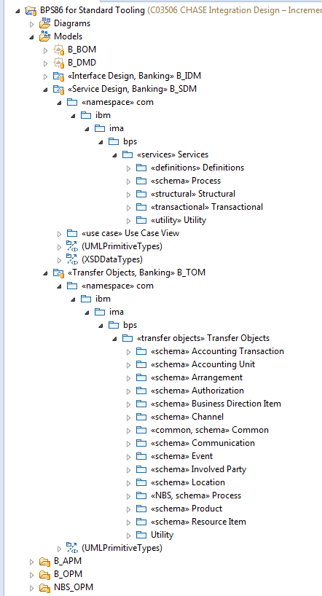
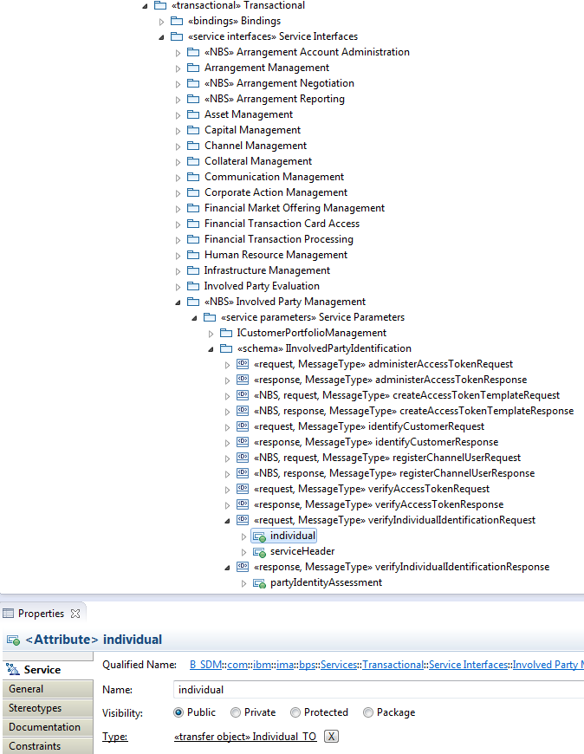
RSA tooling allows for the creation of a canonical TOM
Notes:
Say:
There are several layers in the NEM architecture that can execute processes. EPO, LRPO, ESB (BPEL)

Slide 8
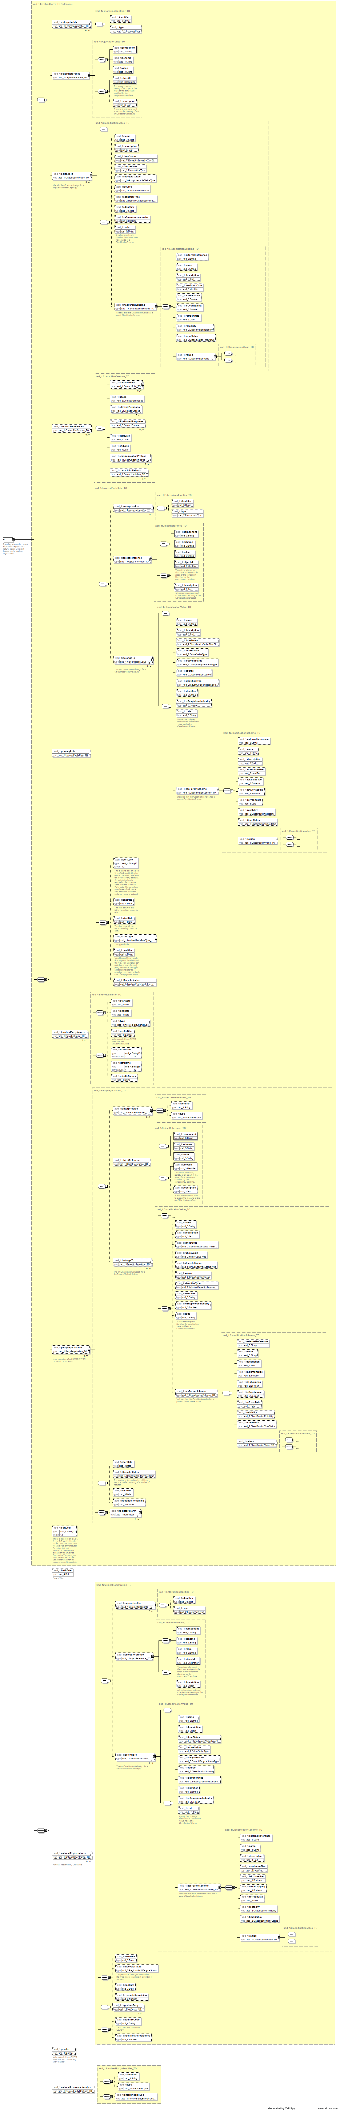
Message schemas (XSDs) were generated automatically from the TOM. Example: “Individual” Transfer Object (inc 3)

Slide 9
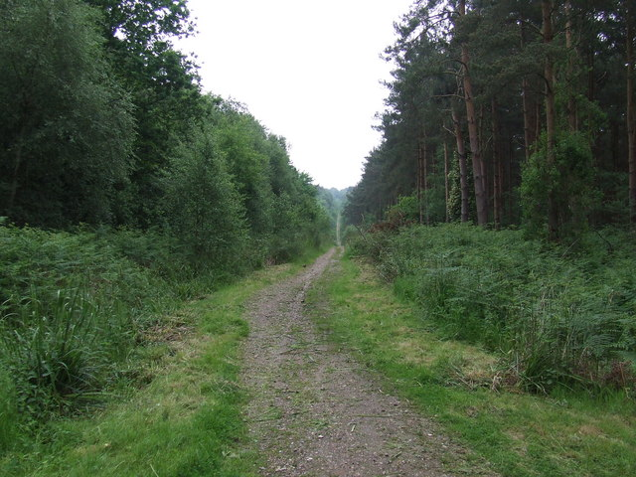
Evolution of NEM Service Design
IFW Generated
Fire Break
Trimming
Direct Design

Slide 10
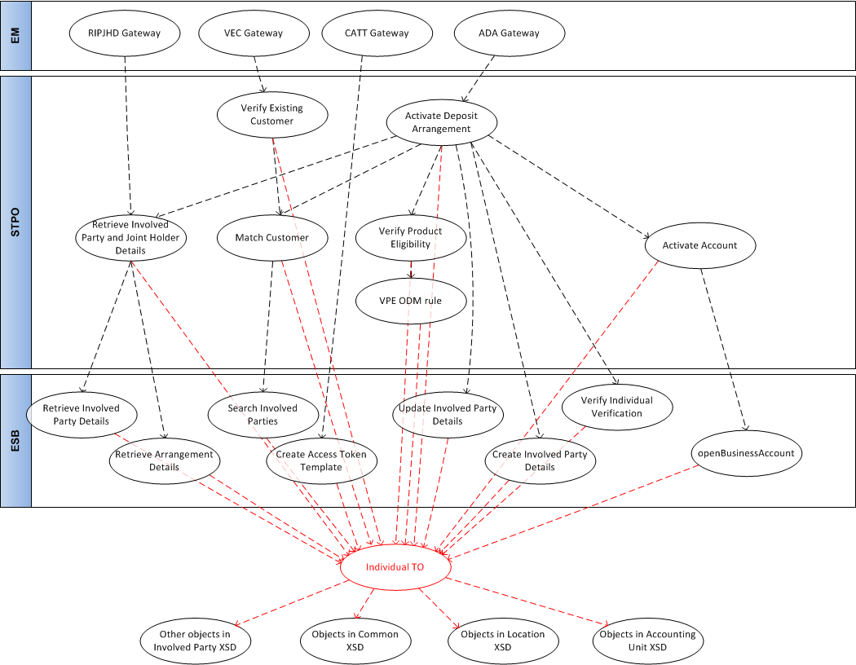
Dependency diagram centred around a single object:
“Individual_TO” (increments 1-3 only)
A single change could affect anything above it.
Notes:
Say:
There are several layers in the NEM architecture that can execute processes. EPO, LRPO, ESB (BPEL)

Slide 11
Fire Break Solution
Each service has its own Transfer Object Model, each based on a common IDM.
Schema changes, e.g. to support defect fixes, will be made to these specific models, and not to the generic model.
  The model may be updated too, but this happens at a different timescale
Each service (and process), and its corresponding schema, will be managed and versioned independently of other services (and processes).
A negative is that more mapping is required.
BOM
IDM
SDM Service A
SDM Service B
SDM Service C
TOM A
TOM B
TOM C

Slide 12
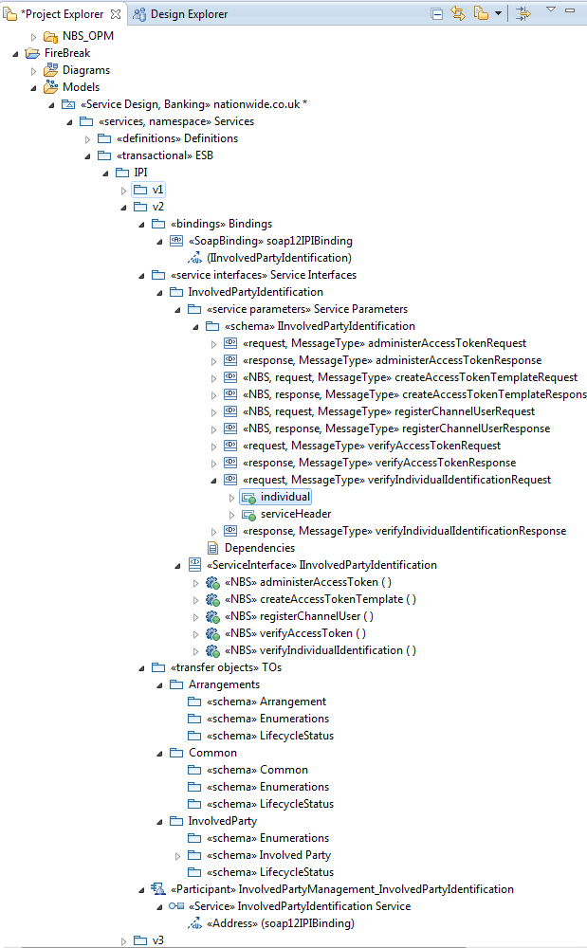
Fire Break RSA View
Involved Party Identification Service
It is now possible to manage service versions in the model
Dependency diagram per version
Transfer Objects belonging to the service.
We are proposing multiple operations per logical service, sharing the same TOM. (Physically a single operation per service continues unchanged)

Slide 13

Evolution of NEM Service Design
IFW Generated
Fire Break
Trimming
Direct Design

Slide 14
Why are message schemas useful?
Message schemas define the valid structure of a message. They are a powerful tool for:
Reducing defects. Schemas are used by senders to check that their message will be accepted by the receiver. Validity can therefore be tested in isolation, earlier in the project, without need for an integration test, and there will be fewer integration test defects as a result.
Faster development. Without schemas you would have to code the corresponding message validation, often in multiple places, and produce further code to deal with errors arising from this.
Improving Security. Schemas are used by receivers to protect themselves against malformed messages. This could also be done by hardware devices (DataPower).
Generating test tools. Schemas can be used to generate test stubs and test injectors (e.g. using SOAP UI), making testing quicker and more accurate.
Accelerating design. If a schema specifies the message unambiguously, there is less need for additional design documentation.

Slide 15
XML Schemas: none vs. loose/broad vs. tight/narrow
Valid Messages
(from a business viewpoint)
Messages that comply with
a “tight” (or narrow) schema
Messages that
comply with a
a “loose”
(or broad)
schema
Well-formed XML messages
Because of schema re-use,
schemas are necessarily “loose” (or broad)
The space of all possible messages

Slide 16
XML Schemas: none vs. loose/broad vs. tight/narrow
Valid Messages
(from a business viewpoint)
With loose schema, you should test
that messages in this space result
in appropriate service behaviour.
That’s a lot of tests

Slide 17
XML Schemas: none vs. loose/broad vs. tight/narrow
Valid Messages
(from a business viewpoint)
With tight schema there are significantly fewer of such tests

Slide 18
Why trim existing services?
Why trim and not redesign?
  Trimming does not affect existing consumers and services already built and tested, other than having to re-import a new set of WSDLs and XSDs.
Why trim at all?
  Trimmed schema do provide tighter, machine readable, definitions of the services, with the associated advantages discussed.
Valid Messages
(from a business viewpoint)
Messages that comply with
a “tight” (or narrow) schema
Messages that
comply with a
a “loose”
(or broad)
schema
Messages that comply with
a trimmed schema

Slide 19
Example: CommunicationDispatch, GenerateCommunicationDetails
Asynchronous, Fire-and-Forget service
According to the requirement, the message consists of:
  The Target of the communication
    Individual
    Name
    Role (e.g. account holder)
    Registration
  Purpose (e.g. template ID)
  Contact Points communication is targeted at
  A Content Object, a polymorphic type based on “Business Model Object”

Slide 20
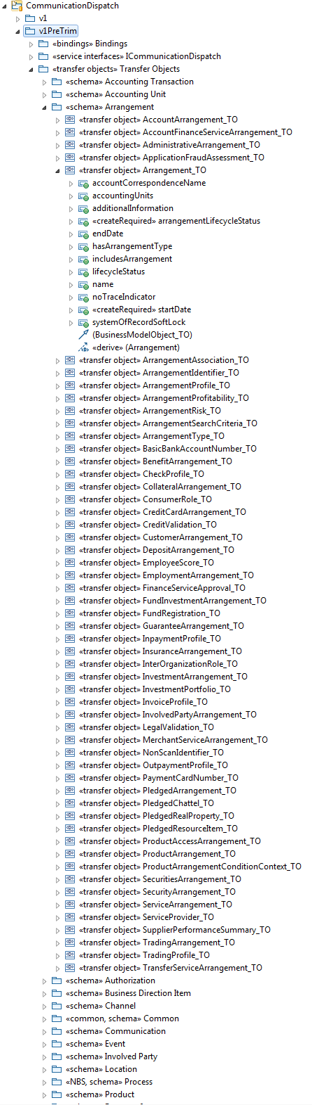
TOM before “Trimming”

Slide 21
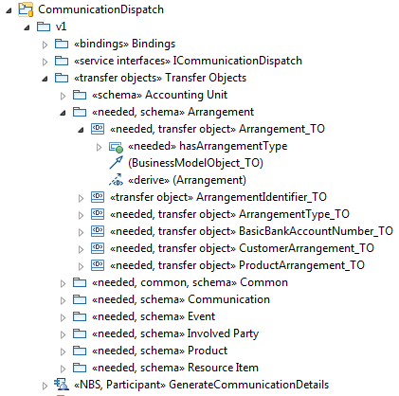
TOM after “Trimming”

Slide 22
But…. trimming still retains structural complexity from the base IFW models
“Vertical complexity”
  Let’s say an account and a customer inherit from the same class each via their own hierarchy of superclasses, but the account needs field A in that class, and the customer needs field B. In this case both the account and customer will have both fields in their schema, plus the class hierarchy
“Horizontal complexity”
  If a data field is needed in class A, which is part of class C, but class C is accessed via class B in class A. Then class B is needed just to provide access to class C, and class C is needed just to provide access to class A.
  Example: Contact Preference

Slide 23
Example – Communication Preferences
CIS
BOM (and current design representation)
Individual
DoNotMailIndicator
DoNotEMailIndicator
DoNotPhoneMailIndicator
DoNotSMSMailIndicator
CommunicationProfiles
InvolvedParty
ContactPrefernces
ContactPoint
ContactLimitation
Individual
Electronic Address
Postal Address
Phone Number

Slide 24

Evolution of NEM Service Design
IFW Generated
Fire Break
Trimming
Direct Design

Slide 25
Service Design has a number of inputs
HLDs
OPM2
NEM DC
Service
DESIGN
OPM1
WSDLs & XSDs
Use Cases
IN
OUT
XSD – SoR mapping
Req -SoR Mapping
Supplementary spec
BOM

Slide 26

What did Jobs say?
Simplicity is the ultimate sophistication
To design something really well, you have to get it. You have to grok what it’s all about.
Never let a passion for the perfect take precedence over pragmatism

Slide 27
We have a set of Service Design Principles
From Rob Jackson, AMSB 16/3/16
Base principles
Software components should be built to available requirements and SOA Services are no different. Trying to predict future project requirements when performing the design and build of Services leads to ‘analysis paralysis’ and rarely delivers components that are any more likely to be re-use without change.
  History shows that organisations can expend significant time analysing what extra should be done to meet potential future requirements.
Therefore, it is not recommended that we try to predict future project requirements when performing service analysis, design or build.
However, pragmatic generalisation principles can be applied to Service design to make change easier and/or less likely. These principles focus on ensuring the right type and quantity of logic appear in a service rather than predicting requirements.
Guidelines for reducing the impact of change
Services should be stateless
Service must be versioned and support ‘side-by-side’ deployment. That is, they must support multiple concurrent versions in production
Services changes must be possible without impacting consumers.
Services should be composable, i.e., a new Service can be composed from other Services.
Service interfaces should be based on Nationwide’s standard data model (based on IFW)
Security logic (authentication & authorisation) should be separate from business logic
The way a consumer interfaces with a Services should be standards based, i.e., SOAP, JSON/REST, HTTP, MSMQ and MQ.
Service interfaces should only define data required for their correct operation.
Services should be designed and built to a defined set of patterns, e.g., Request/Reply, Assured Delivery, etc.
Overlap: minimising the overlap between the scope of different services, and the data they deal with.
Cohesion: operations within a service should relate to one another and are likely to change together.
Granularity: a service should have sufficient responsibility to warrant being managed as a component of its own right
Delivery opportunities
Once project requirements for Service creation or change have been identified, consideration should be given to other projects operating in the same space. To avoid unnecessary versions of a service, opportunities to consolidate requirements to deliver a single code drop should be explored.
A ‘factory’ approach utilising code-generation and componentisation should be used to reduce the cost of future iterations of Services.

Slide 28
Achieving high quality designs efficiently
High quality is achieved by
  Focusing on the needs of the customers, being:
    The build team processing the next stage
    Service consumers (EM, BPM)
    Test teams
    The programme (to validate that requirement is being met)
  Clear traceability back to a set of guidelines / principles / patterns
  Minimising the number of errors caused by hand-overs / translation steps*
Efficiency is achieved by
  Minimising the number of steps, i.e. only include those that add value to the end-result*
  Using automation
* Lean principles

Slide 29
What is “Direct Design”?*
A “back-to-basics” approach to designing service schemas
During integration design, A&D inputs are used to directly design transfer object models in RSA.
Schemas will be self-contained. WSDLs and XSDs are to serve as near-complete service interface specifications.
The terms in the XSDs are based on the same common language as the requirement has been expressed in (e.g. the BOM).
Where complex data requirements arise, base models (e.g. the BOM) and other service TOMs can be used to guide service design decisions.
“Direct Design” recognises that different types of service operation require different design approaches.
The TOMs will not be automatically generated from other models.
There are different options available with regards to ensuring that TOMs are consistent with one another.
* “Direct Design” is not an officially recognised industry term, but made-up in order to illustrate the difference with the current design method

Slide 30
Design involves identifying (sub-)components.
What is a component?
A component….
offers cohesive group of related functions which often change together
can be (re-) used by other components
has limited to no overlap with other components
is versioned independently
can be individually tested
is individually documented
can be deployed separately from other components
A Service Is A Component
* The IFW meaning of “component” is different. We are not using this meaning here.

Slide 31
Designing different Service Operation Types
Type | Request Schema Size | Response Schema Size | Request Constraints | Operations in SO1 | Synonyms
Create | M | L | H | 8 | Record
Retrieve | L | H |  | 8 | Read
Search | L | M |  | 7 | List
Update | M | L | M | 2 | Modify, Record
Calculate | L | L |  | 2 | Simulate, Determine
Generate* | L | L |  | 3
Verify | M | L | L | 12 | Validate, Determine
Send Event* | H | M | L | 4 | Generate, Record
Activate | M | L | H | 6 | Fulfil, Administer, Apply, Update
* GenerateCommunicationDetails is a “Send Event” type operation

Slide 32
Schema Design by Service Operation Type
Type | Schema Design Considerations
Create | Scope driven by project requirement, and constraints are driven by the SoR.
Retrieve | Should be larger scope, covering significant (if not all) part of SoR service, with loose response constraints to cope with SoR data issues.
Search | Small summary objects in response. Performance considerations drive the amount of information returned.
Update | Scope driven by project requirement. No mandatory elements other than object key.
Calculate | Small schema, keep it simple based on project requirement
Generate | Small schema, keep it simple based on project requirement
Verify | “Verify” processes can accept object keys as input, whereas “verify” services (ODM or ESB) need the actual object being verified as input. Schema constraints may be loose and may follow the lead of “Retrieve” as it is the rule that does the verification. Sometimes a proper object is not available, for example when verification takes place before fulfilment, in which case a set of fields (UK residency, age) can be provided as alternative to the “retrieved” object (e.g. “Individual_TO”)
Send Event | Typically audit or comms services. Scope combines project requirement and SoR requirement.
Activate | Scope driven by project requirement. What is submitted in the request should often be considered as a basic “application form”. There is no need for ready-made objects that don’t exist in an SoR yet. Constraints are driven by the project requirement, the need of the business process.

Slide 33
Example 1: New SO2 Service: Bank Account Validation

Slide 34
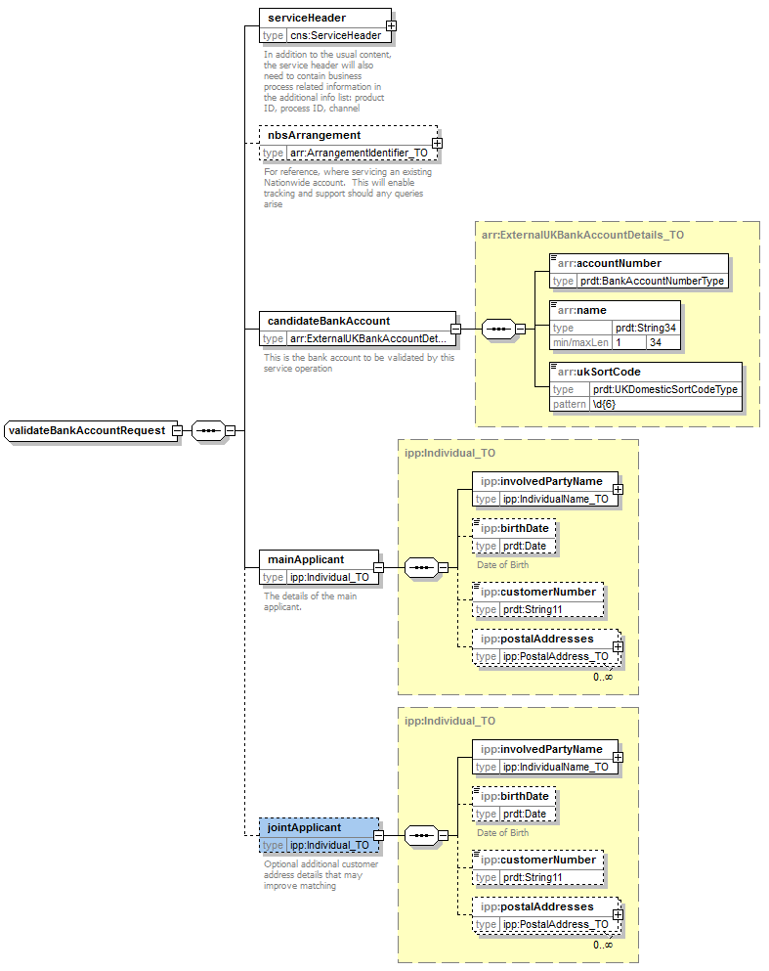
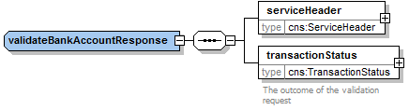
Outcome

Slide 35
Documentation generated from model
Audit info added here
As per requirement
Flattened, No object ref
Slimmed down object. Optional / Mandatory as per requirement

Slide 36
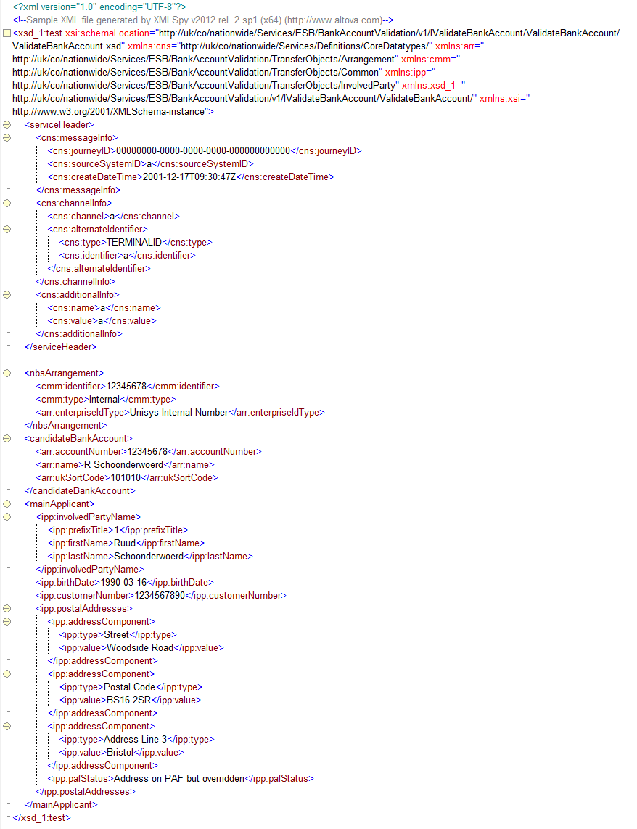
Sample Message

Slide 37
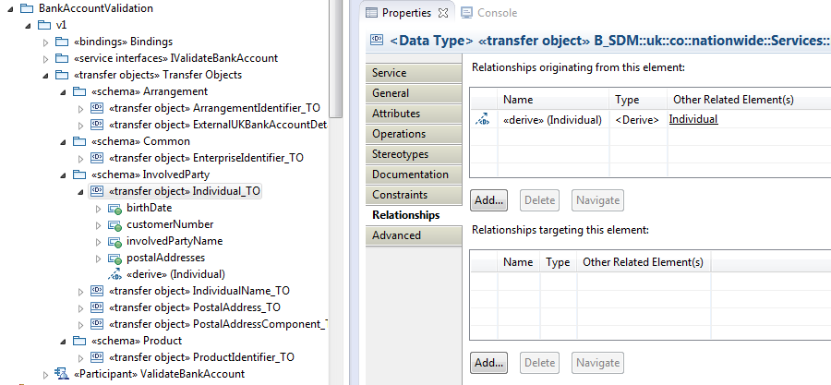
BOM Traceability

Slide 38
Example 2: InvolvedPartyManagement SO1 Analysis
Operations in current version
CreateInvolvedParty
RecordSignificantCustomerEvent
RetrieveInvolvedPartyDetails
RetrieveIPArrangementDetails
SearchInvolvedParties
UpdateInvolvedPartyDetails
Odd ones out:
RecordSignificantCustomerEvent
  “Send Event” type operation
  Data requirements are primarily on the “Event” area of the IFW model.
  From “InvolvedParty” it uses only an identifier and name.
  It uses “Product” and “Arrangement” also, but only limited information again.
RetrieveIPArrangementDetails
  “Search” type operation
  Uses very little of “InvolvedParty”: the schema is almost entirely in the “Arrangement” space
Recommendation: move these elsewhere
InvolvedPartyManagement is the “master” of the representation of Involved Parties
It does not need to worry about representations of other areas (e.g. Arrangements) and only contain references to these
Other areas can contain only references, or summary info, to Involved Party information
The resulting service would only contain create, read, update, search operations

Slide 39
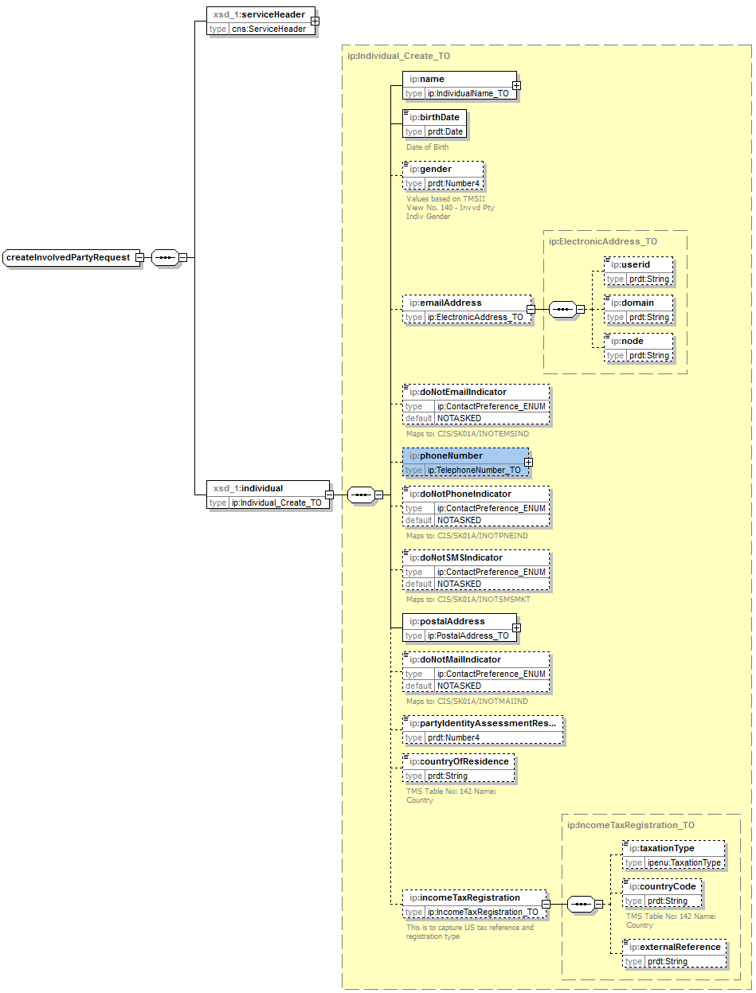
InvolvedPartyManagement
This is how the schema for the request part of one of the operations – “CreateInvolvedParty” would have looked with a “Direct Design” approach.

Slide 40
InvolvedPartyManagement
Flattened. Email address, Postal address, Phone number don’t inherit from Contact Point
Separate object to enable constraints specific to the operation
Scope determined by project requirements
Separate ENUM mirrors CIS. In current BOM/TOM this is a complex object structure, with complex mapping.
Flattened. Was a 6-level deep hierarchy, but the requirement is only for these fields

Slide 41

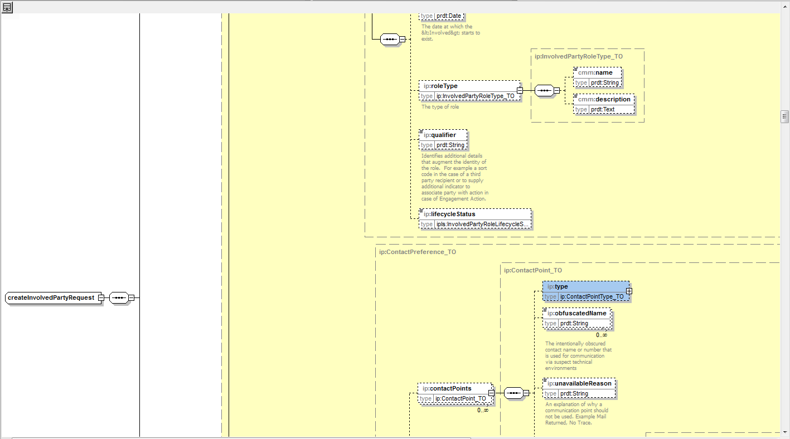


Compared to what it was…

Slide 42
Questions?

